Slide 1
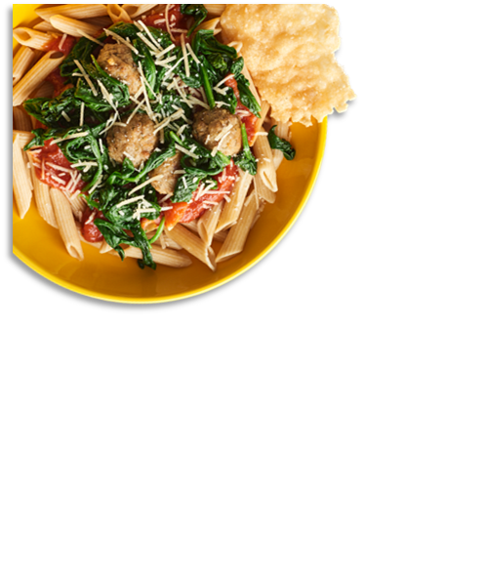
April 2025
Fraser PS Head Start
Lunch Menu
Ages 1 – 5 Years Old
Fraser Public Schools provides lunches for Head Start at:
Mt. Clemens
MISD
Dooley Early Childhood Center
 | MON |  | TUES |  | WED |  | THURS |  | FRI
 |  | 1 |  | 2 |  | 3 |  | 4
7 |  | 8 |  | 9 |  | 10 |  | 11
14 |  | 15 |  | 16 |  | 17 |  | 18
21 |  | 22 |  | 23 |  | 24 |  | 25
28 |  | 29 |  | 30
Beef Soft Tacos
Diced Pears
Sweet Golden Corn
WG Popcorn
Chicken Bowl
Mixed Fruit
Sliced Carrots
WG Turkey Sausage, Egg & Cheese Breakfast Burrito
Warm Cinnamon Apples
Tater Tots
WG French Bread Cheese Pizza
Apricots
Steamed Broccoli
WG indicates items that are made with whole grains.
WG Cheese Quesadilla
Pineapple Tidbits
Black Beans
WG Chicken Patty Sandwich
Diced Pears
Romaine Salad
WG Mini Waffles
Scrambled Eggs
Warm Cinnamon Peaches
Tater Tots
WG Personal Pan Cheese Pizza
Orange Wedges
Green Beans
No Head Start
Chicken Alfredo
Dinner Roll
Sliced Strawberries
Steamed Broccoli
Cheeseburger on a WG Bun
Applesauce
Baked Beans
Rotini w/ Meat Sauce
WG Breadstick
Mixed Fruit
Green Beans
WG Pancakes w/ Syrup
Turkey Sausage Links
Diced Peaches
Waffle Fries
No Head Start
All Lunches Must Include Choice of:
Fruits and/or
Vegetable
1% Low-Fat Milk
WG Mini Chicken Corn Dogs
Mandarin Oranges
French Fries
WG Macaroni & Cheese
Mixed Berries
Diced Carrots
WG Chicken Tenders
WG Dinner Roll
Diced Peaches
Baked Beans
WG Sweet & Sour Popcorn Chicken
Pineapple Tidbits
Steamed Broccoli
WG French Bread Cheese Pizza
Applesauce
Mixed Vegetables
WG Popcorn Chicken
WG Cheez-It Crackers
Diced Pears
Green Peas
WG Bosco Cheese Sticks
Marinara Sauce
Mixed Fruit
Steamed Broccoli
Chicken Soft Tacos
Diced Pears
Refried Beans with Cheese
Menus are subject to change.
All lunches are served family-style and include choice of:
Fruits and/or
Vegetable
1% White Milk
Condiments
This institution is an equal opportunity provider.

